Slide 1



Topic
Silk Worm Life Cycle & Culture
MOHANLAL
SUKHADIYA
UNIVERSITY
UDAIPUR
Department of Zoology
B.Sc.-II-Year
Practical Zoology
By
SAHA DEV JAKHAR

Slide 2
Classification
Kingdom: | Animalia
Phylum: | Arthropoda
Class: | Insecta
Order: | Lepidoptera
Family: | Bombycidae
Genus: | Bombyx
Species: | B. mori

Slide 3
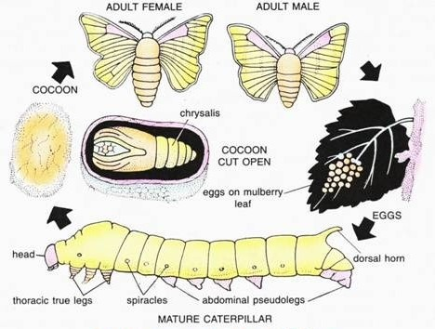

Slide 4
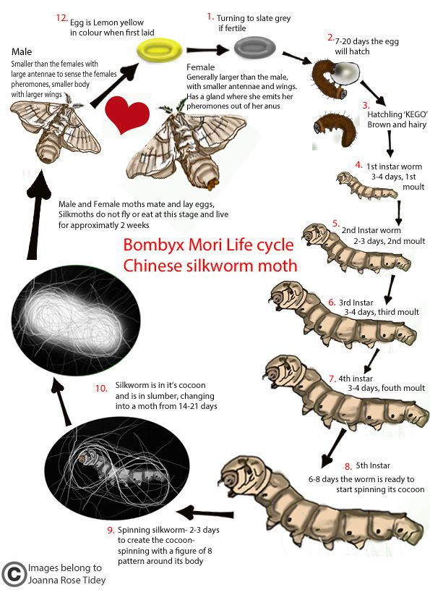

Slide 5
Eggs take about 14 days to hatch into larvae, which eat continuously.
They have a preference for white mulberry, having an attraction to the mulberry odorant cis-jasmone.
They are not monophagous, since they can eat other species of Morus, as well as some other Moraceae, mostly Osage orange.
They are covered with tiny black hairs. When the color of their heads turns darker, it indicates they are about to molt. After molting, the larval phase of the silkworms emerge white, naked, and with little horns on their backs.
After they have molted four times, their bodies become slightly yellow, and the skin becomes tighter.
The larvae then prepare to enter the pupal phase of their lifecycle, and enclose themselves in a cocoon made up of raw silk produced by the salivary glands.
The final molt from larva to pupa takes place within the cocoon, which provides a vital layer of protection during the vulnerable, almost motionless pupal state.
Many other Lepidoptera produce cocoons, but only a few—the Bombycidae, in particular the genus Bombyx, and the Saturniidae, in particular the genus Antheraea—have been exploited for fabric production.
Pupa releases proteolytic enzymes to make a hole in the cocoon so it can emerge as an adult moth.

Slide 6
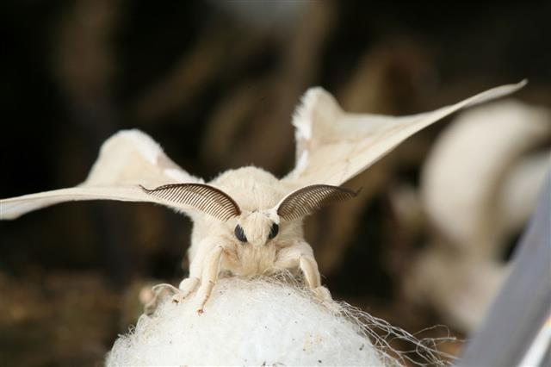
Silk Moth Adult

Slide 7
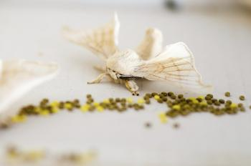
Eggs

Slide 8
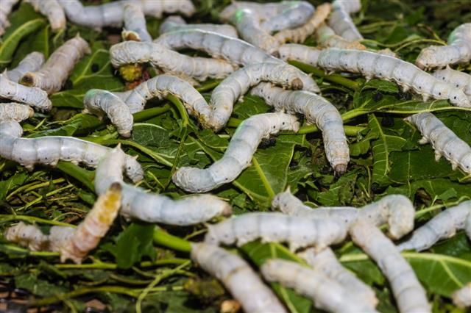
Silk worm larva

Slide 9
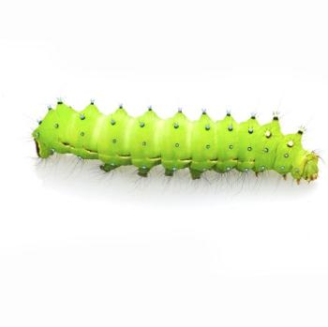
Silk worm larva

Slide 10
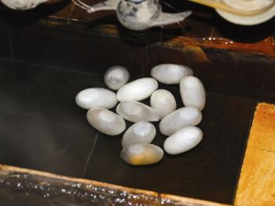
Cocoon

Slide 11
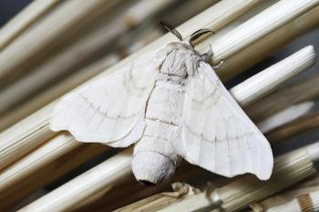
Silk Moth Adult

Slide 12
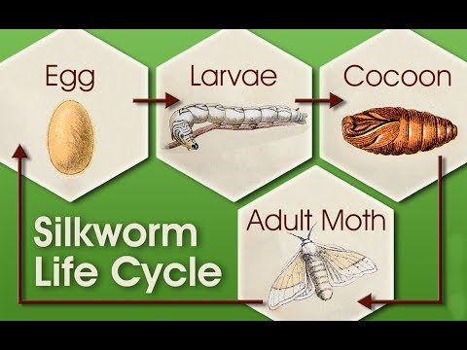

Slide 13
Thank You

